Slide 1

STM32 Workshop
By Moktar SELLAMI

Slide 2
Plan
1
5
2
6
3
7
4
8
Why you should be here ?
STM32
Intro to embedded systems
Let’s do something
Microcontroller
STM32 GPIO
Motherboard VS Microcontroller
GPIO output STM32 and HAL

Slide 3
Why you should be here ?
The field (AI, Cybersecurity, IoT) …
Why STM32?
What you will learn

Slide 4
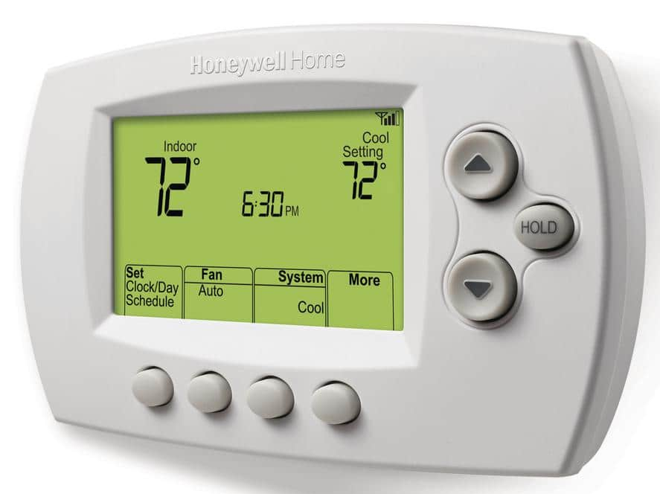
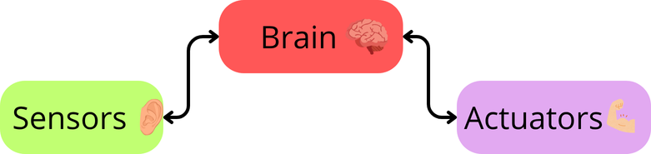
Introduction to embedded systems
Embedded systems are specialized computing systems designed to perform specific functions within larger systems.
Thermostat

Slide 5
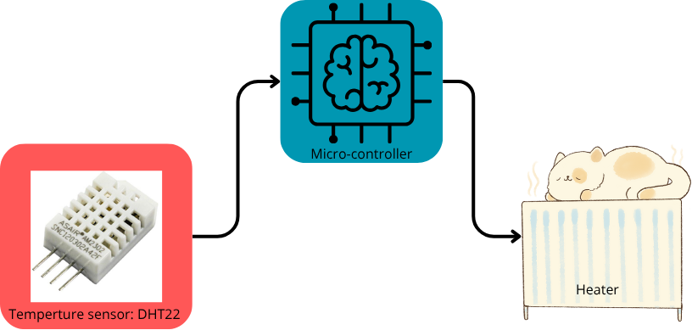
Introduction to embedded systems
THE BRAIN :

Slide 6
Microcontroller
A microcontroller is a compact integrated circuit that integrates many components.
It is categorized with its limit resources:
Low processing power : 12 Mhz to 700 Mhz
Low memory capacity: 2KB to 1MB
Low storage capacity: 4KB to 20MB
Energy consumption: 10 mW to 2W

Slide 7
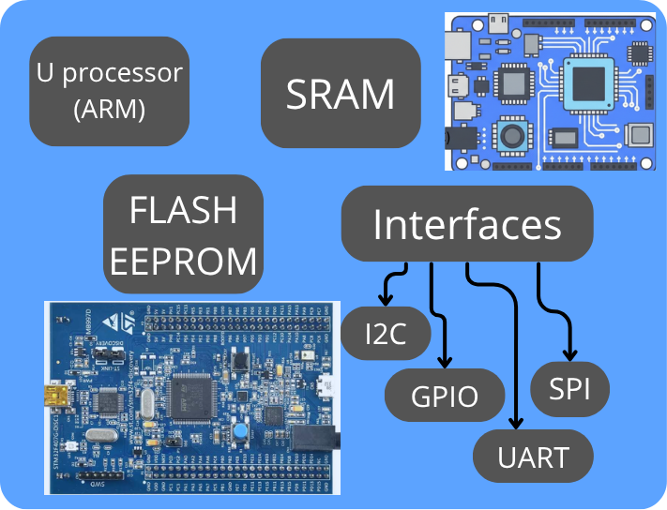
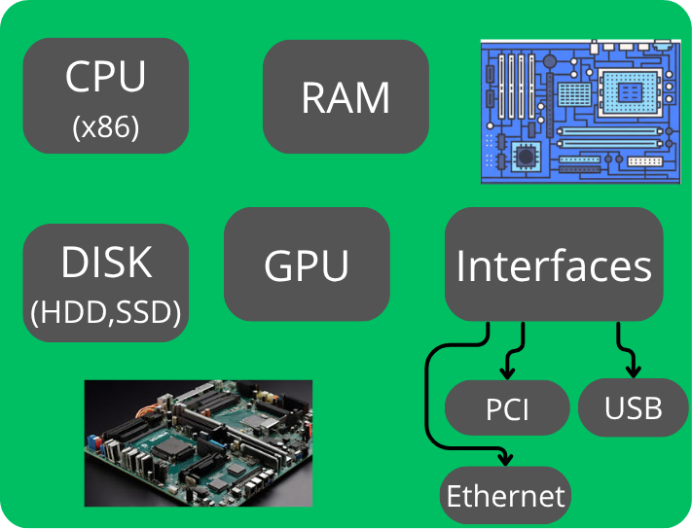
Analogy between motherboard and Microcontroller
Microcontroller
Motherboard

Slide 8
STM32
What is STM32?
Family of 32-bit microcontrollers by STMicroelectronics
Use ARM Cortex-M cores (M0, M0+, M3, M4, M7, M33)
Launched in 2007 with F1 series
STMicroelectronics
Largest semiconductor company in Europe
Founded in 1987 (France + Italy merger)
Headquarters: Geneva, Switzerland
49,602 employees, $13.27B revenue (2024)
Families
Mainstream: C0/G0/G4/F0/F1/F3
High Performance: H7/H5/F7/F4/F2
Low Power: L0/L4/L5/U0/U3/U5
Wireless: WL/WB0/WB/WA
AI: N6
Applications & Fields
Industrial automation (PLCs, robots, HMIs)
Consumer electronics (smart devices, wearables)
Internet of Things (IoT)
Medical equipment
Automotive systems

Slide 9

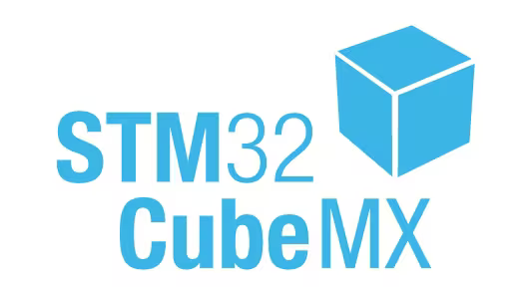
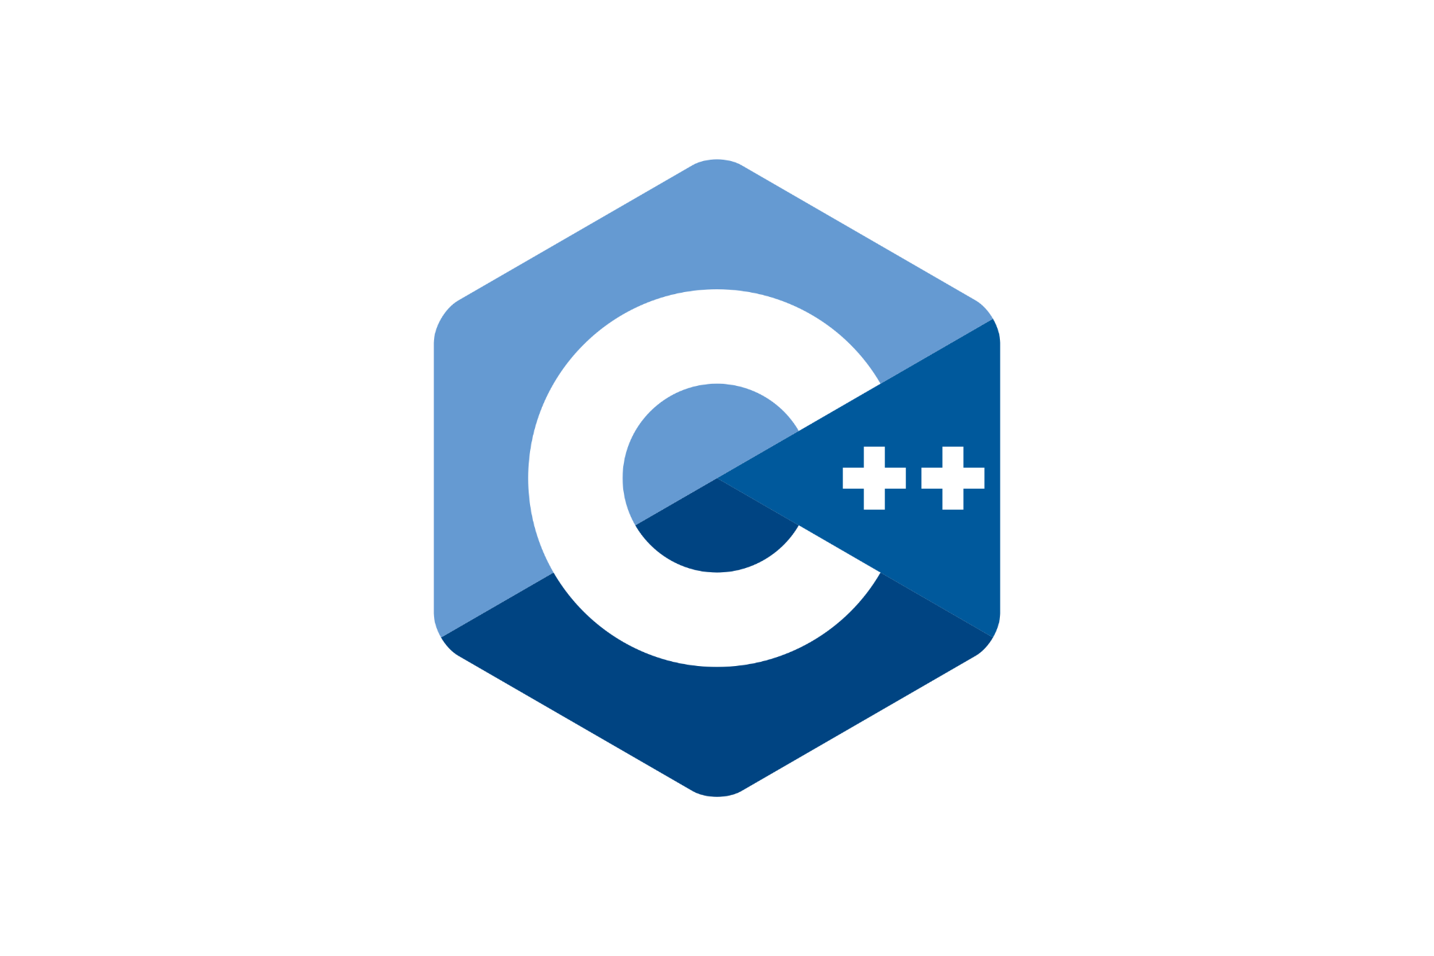





STM32 Ecosystem:

Slide 10
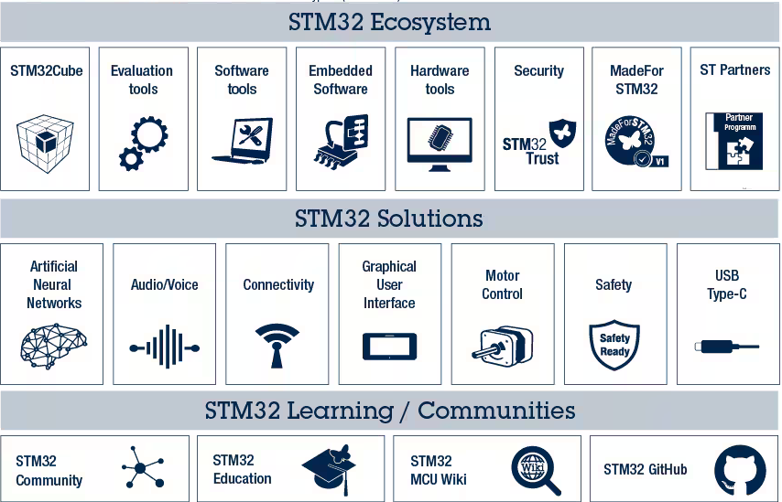

Slide 11
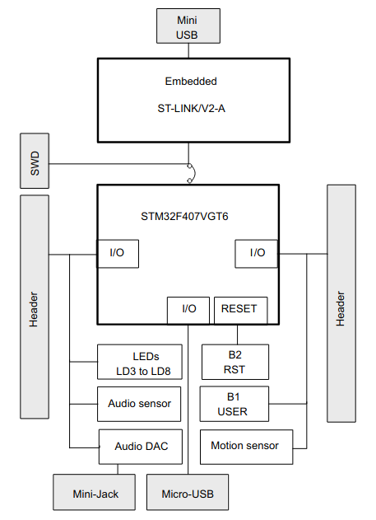
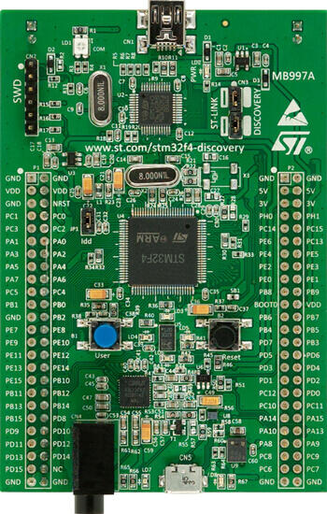
Overview: STM32F407-DISCO1

Slide 12
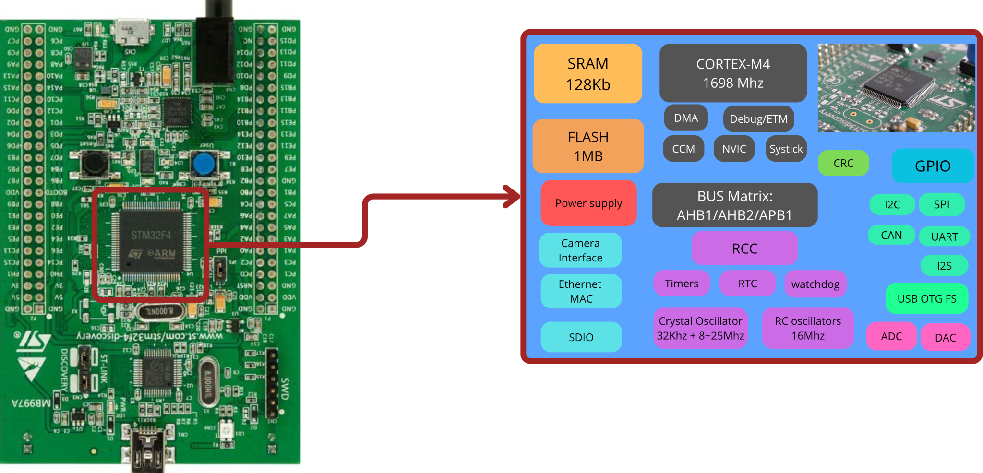
Overview: STM32F407 Microcontroller

Slide 13
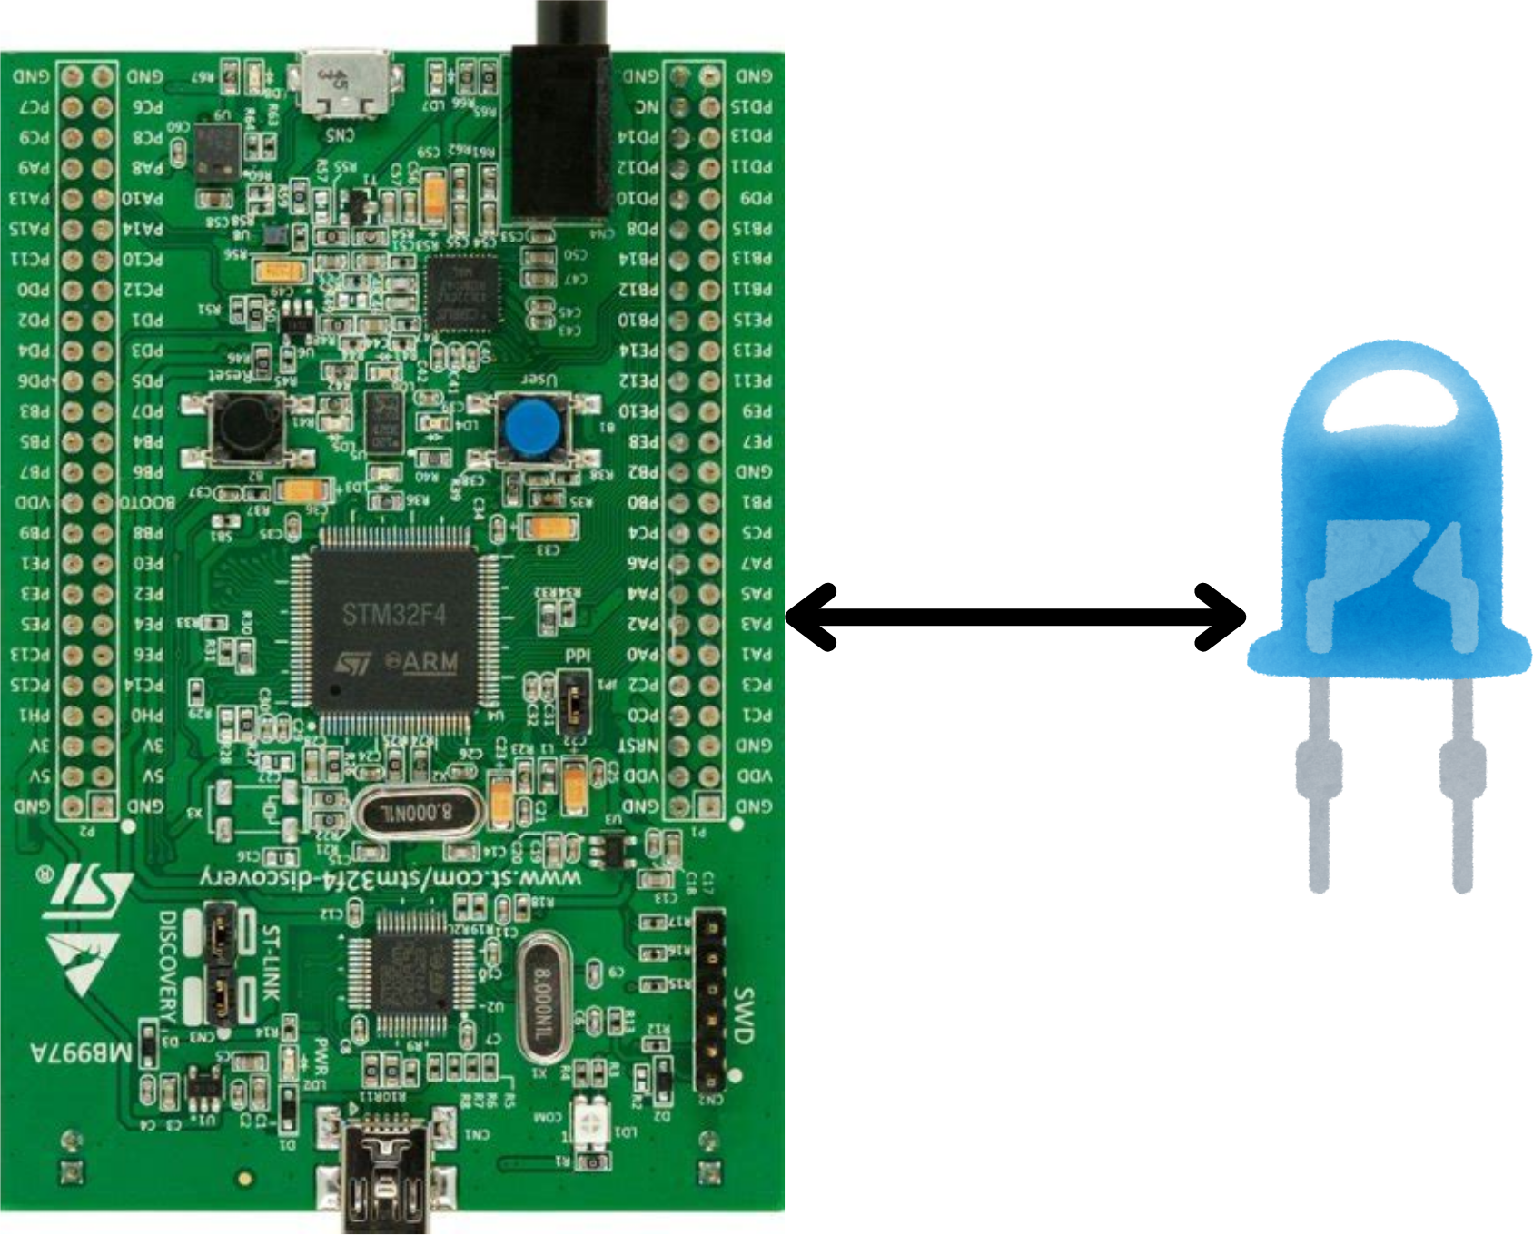
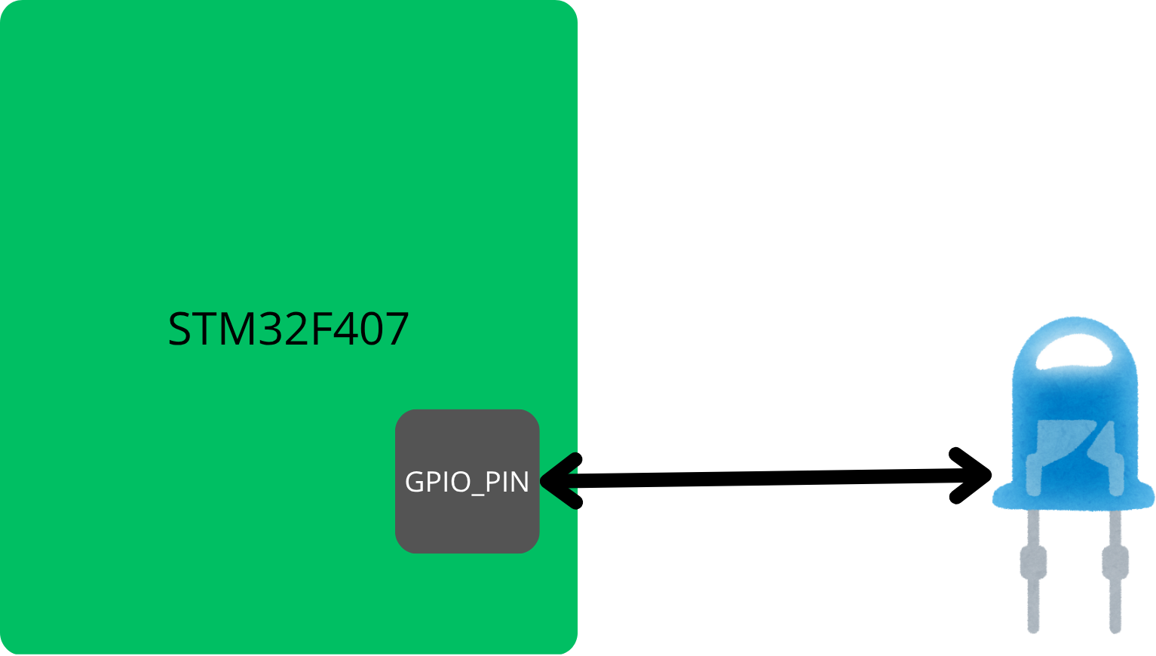
Let’s Do something :
Case Study: Toggling an LED

Slide 14
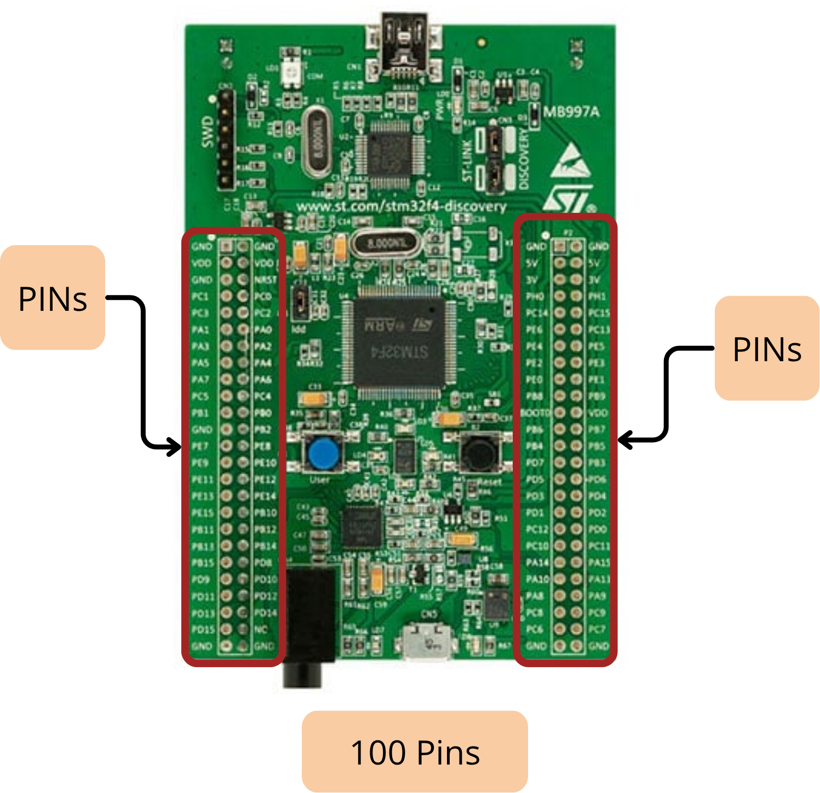
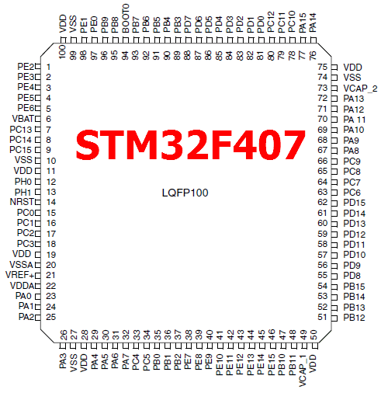
STM32 GPIO : General purpose Input Output

Slide 15
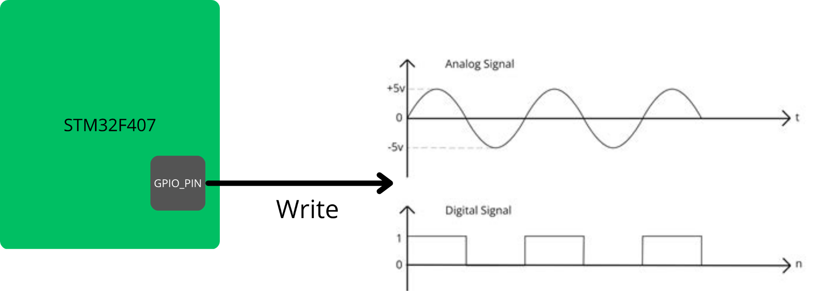
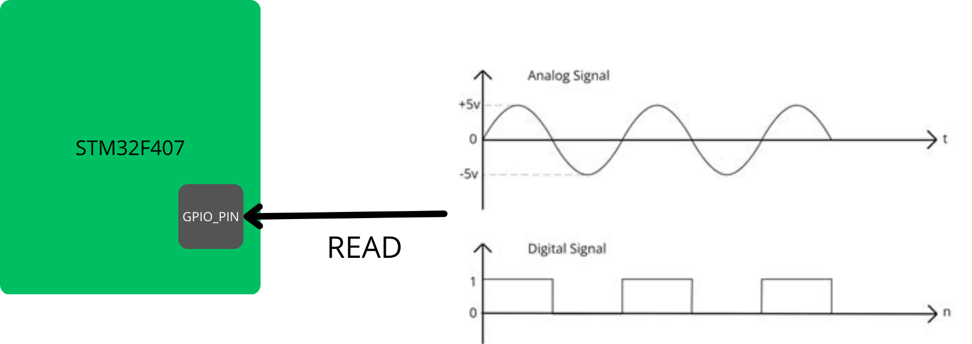
STM32 GPIO : General purpose Input Output
GPIO stands for General Purpose Input/Output. It’s the most basic and versatile feature of a microcontroller, the way it interacts with the outside world.
You can think of a GPIO pin as a configurable electrical pin on the chip that can either:
Send a signal to outside (as an output)
Read a signal coming from outside (as an input)

Slide 16
STM32 GPIO : GPIO Modes
The STM32 groups the GPIOS in to clusters called PORTs indicated by GPIOx .
By x we mean: GPIOA to GPIOI .
Each port has 16 pins: From 0 to 15
For example:
the internal Green LED PD12: GPIOD pin 12
The internal BTN PA0: GPIOA pin 0
The GPIO has 4 Modes:
Input
Output
Alternate function
analog

Slide 17
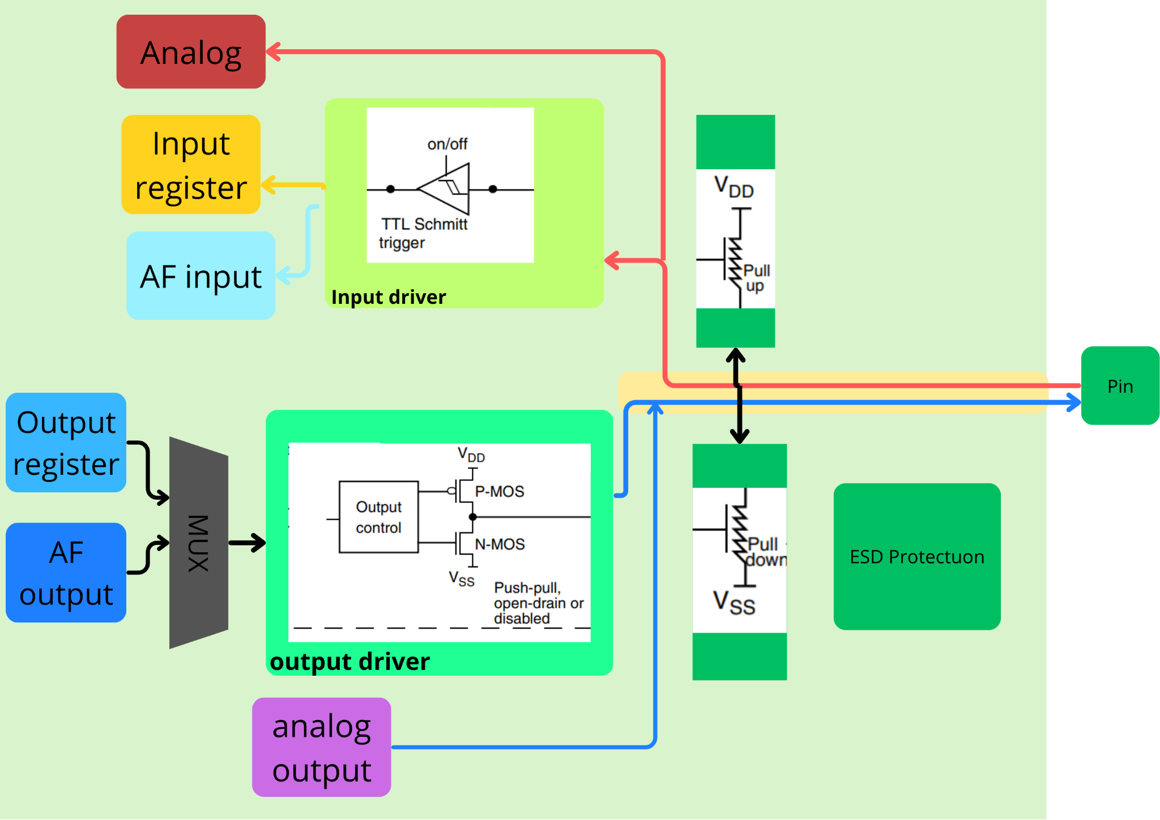
STM32 GPIO : GPIO Structure

Slide 18
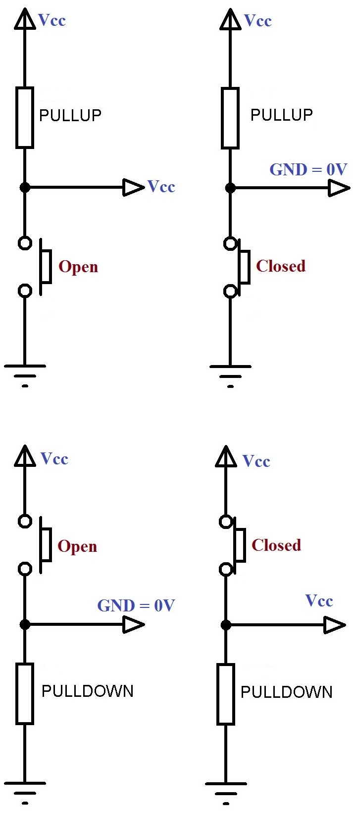
STM32 GPIO : GPIO Modes
Input Mode:
PullUP
NoPull: Floating input
PullDown: The input is set to logic low (0)
PullUp: The input is set to logic High (1)
PullDown

Slide 19
GPIO output STM32 and HAL: blinking an LED:
Toggling an LED
GPIOD
PIN12

Slide 20
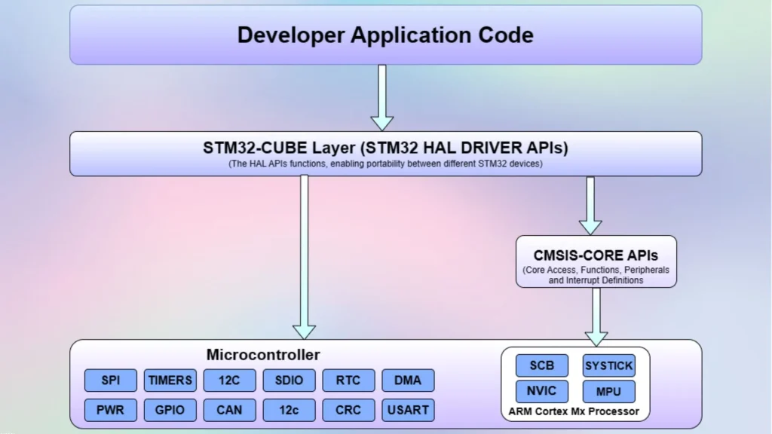
HAL:
I

Slide 21
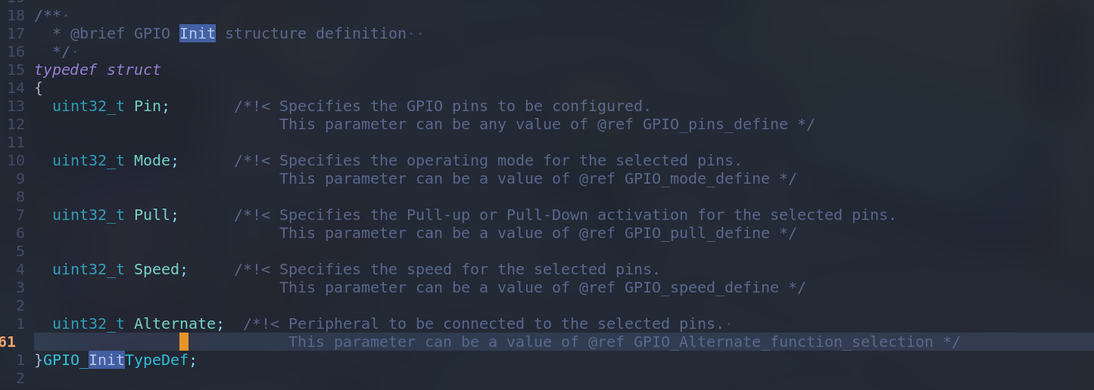
HAL:
GPIO InitStruct
I

Slide 22
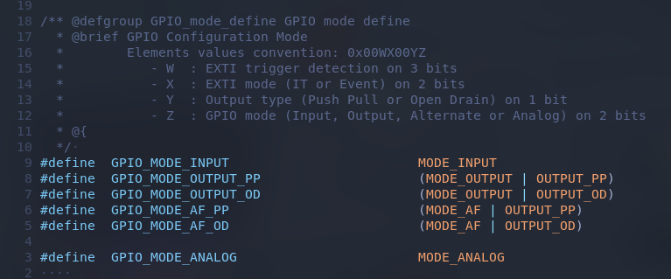
HAL:
GPIO Mode

Slide 23
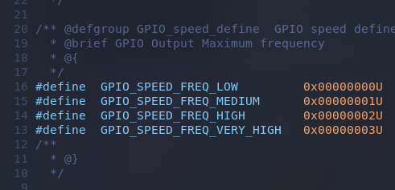
HAL:
GPIO Speed

Slide 24
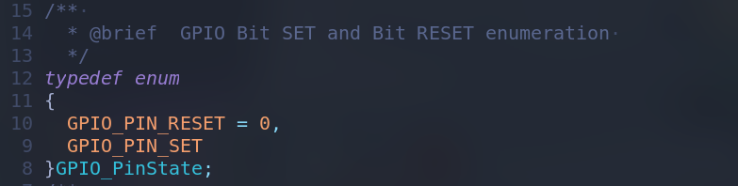
HAL:
GPIO Pin state
I

Slide 25
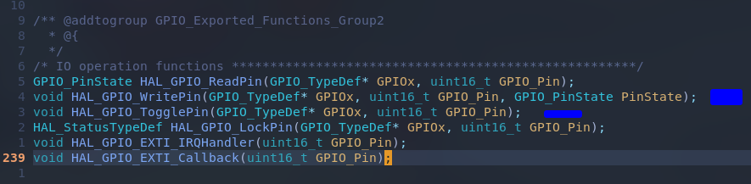
HAL:
HAL function
I

Slide 26
Thank You

